Slide 1
Quantum Machine Learning
By Sachin Namdeo

Slide 2
Agenda
Machine-Learning Refresher
Pain-Points in Classical ML
Quantum Machine Learning (QML) Primer
Why We Need QML
Quantum Data Encoding & Feature Maps
Parameterized / Variational Quantum Circuits
End-to-End QML Workflow
Limitations & Open Challenges

Slide 3

What is Machine Learning ?
Machine learning is a field that focuses on the development of algorithms and statistical models that enable computers to perform tasks without explicit instructions.
By analyzing and learning from large datasets, these models identify patterns, make decisions, and improve over time through experience.
Machine learning is widely used in various fields, including finance, healthcare, and technology, to automate processes, enhance decision-making, and predict outcomes based on data-driven insights.

Slide 4
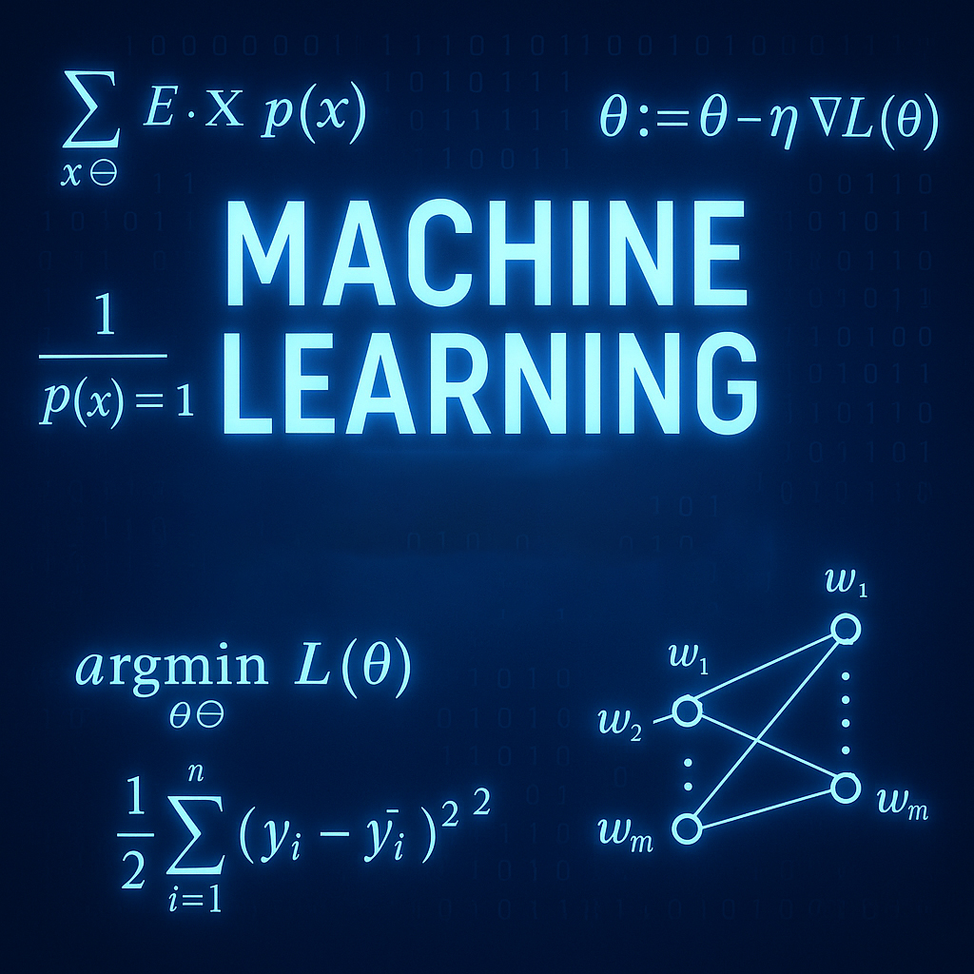
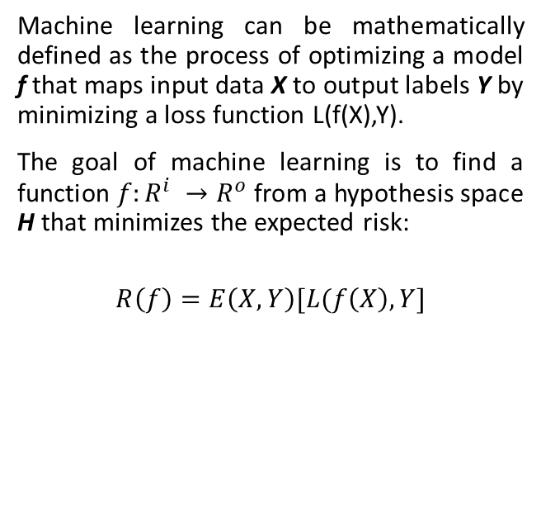
Machine Learning Defined Mathematically
Machine learning can be mathematically defined as the process of optimizing a model f that maps input data X to output labels Y by minimizing a loss function L(f(X),Y).
The goal of machine learning is to find a function $f:R^{i} →R^{o}$ from a hypothesis space H that minimizes the expected risk:
$$R\left(f\right)=E\left(X,Y\right)[L(f\left(X\right),Y]$$

Slide 5
Types of Machine Learning Algorithms
Supervised Learning: The model is trained on a dataset where both the input data and the corresponding output labels are known. Eg: regression and classification tasks.
Unsupervised Learning: The model is trained on a dataset where only the input data is available, and there are no corresponding output labels. Eg: clustering.
Reinforcement Learning: The model learns by interacting with an environment, receiving rewards or penalties based on the actions it takes. Eg: AlphaZero by DeepMind.

Slide 6
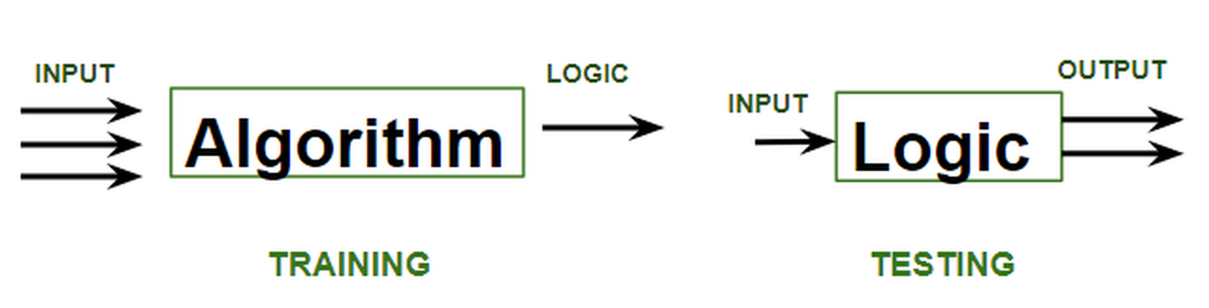
Supervised Learning
Regression: Predict continuous numerical outcomes.
Algorithms: Linear Regression, Polynomial Regression, Ridge & Lasso Regression.
Classification: Predict discrete categories or labels.
Algorithms: Logistic Regression, Support Vector Machines (SVM), Decision Trees, Random Forests, Naive Bayes, k-Nearest Neighbors (k-NN).
Use Cases: Email spam detection, credit scoring, housing price prediction.

Slide 7
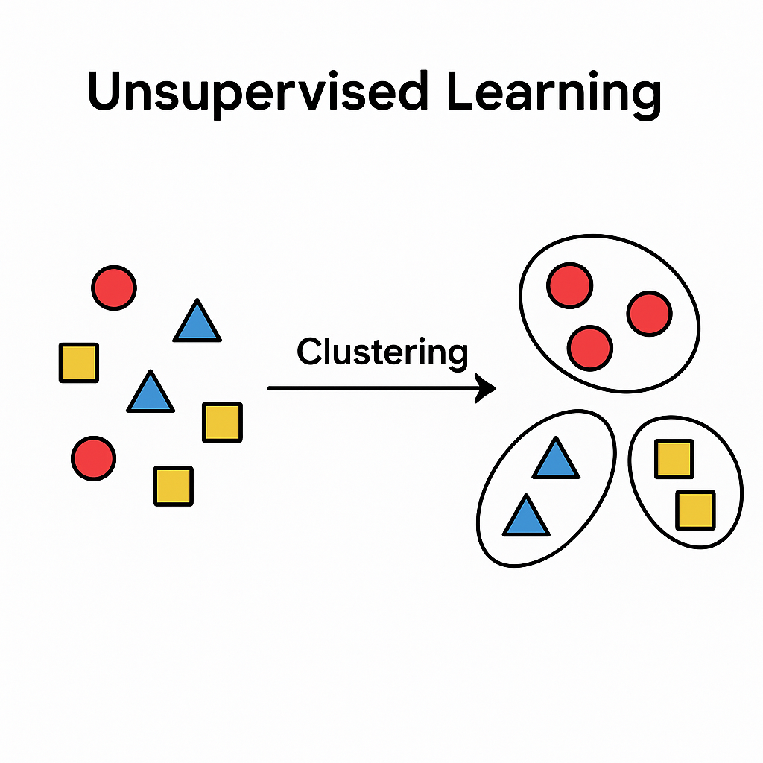
Unsupervised Learning
Clustering: Group similar data points based on features.
Algorithms: k-Means, Hierarchical Clustering, DBSCAN.
Dimensionality Reduction: Reduce feature space while preserving data characteristics.
Algorithms: Principal Component Analysis (PCA), t-Distributed Stochastic Neighbour Embedding (t-SNE).
Use Cases: Customer segmentation, anomaly detection, image compression.

Slide 8
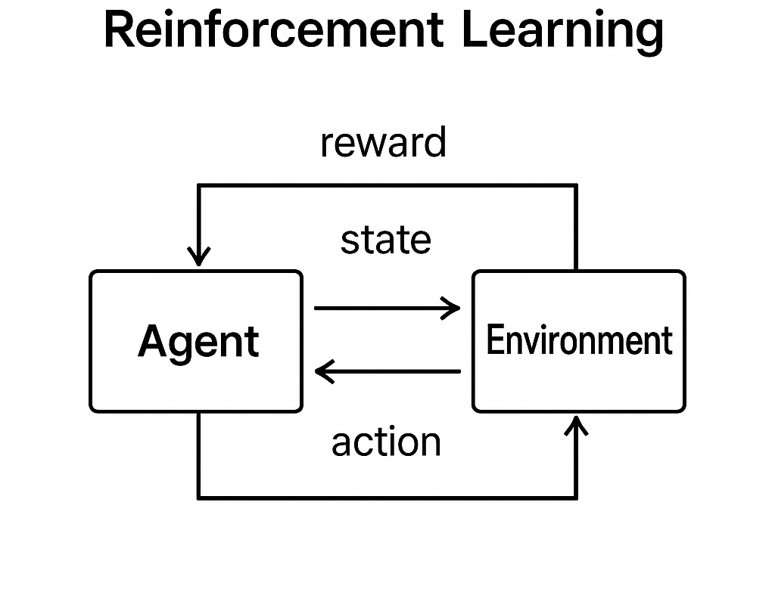
Reinforcement Learning
Core Idea: Agent learns optimal actions through interactions with the environment by maximizing cumulative rewards.
Key Components: State, Action, Reward, Policy.
Algorithms: Q-Learning, Deep Q-Networks (DQN), SARSA, Policy Gradient Methods.
Use Cases: Game playing (Chess, Go), robotics navigation, recommendation systems.

Slide 9
Bottlenecks of Classical Machine Learning
Data Volume & Velocity
Training on massive, continuously growing datasets often exceeds memory or processing capacity.
Batch-based learning requires repeated passes, slowing down real-time or streaming applications.
Feature Engineering Overhead
Manual selection, extraction, and transformation of features is time-consuming and error-prone.
Complex domains (e.g., images, text) demand specialized preprocessing pipelines.
Curse of Dimensionality
As feature count grows, distance metrics become less meaningful and model performance degrades.
High-dimensional spaces exponentially increase computational cost for distance-based or kernel methods.

Slide 10
Bottlenecks of Classical Machine Learning
Training Time & Convergence
Nonconvex optimization (e.g., deep networks) can get stuck in local minima, requiring many epochs or restarts.
Large parameter counts lead to slow gradient updates, limiting experimentation speed.
Scalability & Parallelism Limits
Many classical algorithms do not parallelize efficiently across thousands of cores or distributed clusters.
Synchronization overhead and communication bottlenecks constrain horizontal scaling.
Resource Constraints & Energy Costs
GPUs and high-performance clusters are expensive; training state-of-the-art models can consume significant power.
Organizations with limited budgets struggle to keep up with ever-growing compute demands.

Slide 11
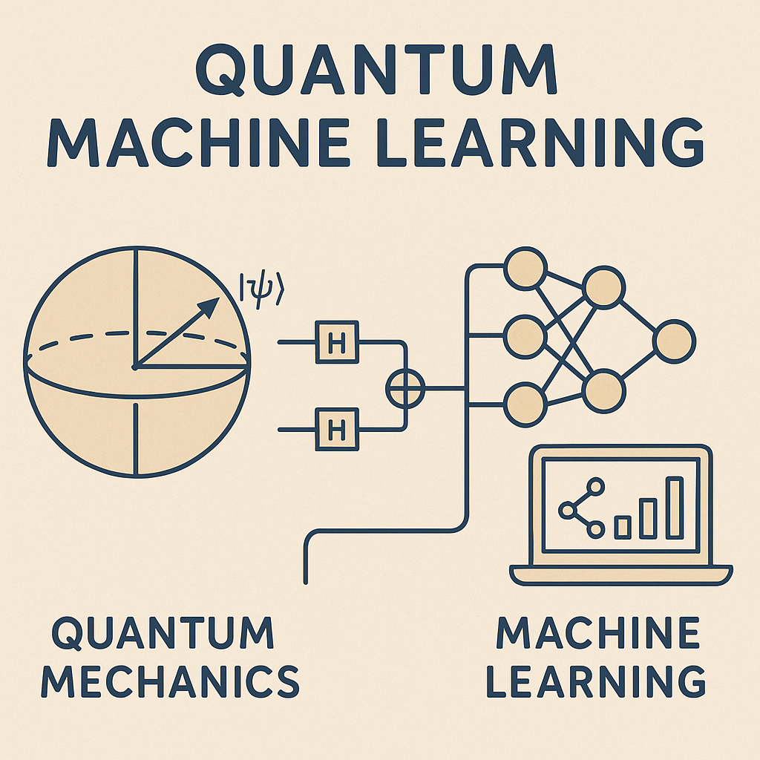
Quantum Machine Learning
In quantum machine learning, quantum algorithms are developed to solve typical problems of machine learning using the efficiency of quantum computing.
The most common use of the term refers to machine learning algorithms for the analysis of classical data executed on a quantum computer, i.e., Quantum-Enhanced Machine Learning.
QML is mostly achieved by designing Parameterized Quantum Circuits (PQCs) or Variational Quantum Circuits (VQCs) and executing the said circuits on quantum simulators such as Pennylane, IBM-Qiskit, etc.

Slide 12
Why do we need QML
Exponential Speedup: Some quantum algorithms, such as quantum SVMs and quantum PCA, offer exponential speedups over their classical counterparts for specific tasks.
Quantum Parallelism: Superposition is especially useful for high-dimensional data, where the curse of dimensionality can make classical approaches inefficient.
Sampling Advantages: Quantum computers can efficiently sample complex distributions, enabling quantum generative models like Boltzmann machines to potentially outperform classical counterparts.
Overcoming Classical Limits: Quantum computing provides a scalable alternative as classical computing nears its limits in power and miniaturization.

Slide 13
Initialization of Qubits
In quantum computing, initializing qubits in the state ∣0⟩ is standard practice for several reasons, especially in the context of Quantum Machine Learning (QML).
Deterministic Start: The state ∣0⟩ is a well-defined, deterministic state, meaning that every qubit is guaranteed to start in the same state. This provides a consistent starting point for all quantum computations.
Clarity in Mapping: It ensures that the encoding process is straightforward, as there are no pre-existing entanglements or super-positions that could complicate the transformation.
Error Minimization: Starting in the ∣0⟩ state reduces the potential for initialization errors, which can propagate through the circuit if the initial state were more complex.
Classical Bit Analogy: In classical computing, bits are often initialized to 0. Similarly, in quantum computing, initializing to ∣0⟩ provides a straightforward analogy and a simple transition from classical to quantum computing paradigms.

Slide 14
The Challenge: Translating Classical to Quantum
Our world runs on “classical” data: numbers, tables, images, text
Quantum computers work in a completely different language, quantum states
Key insight: we must encode classical data into qubits before any quantum magic can happen
Think of it like learning a new alphabet, same story, different symbols

Slide 15
Why Encoding Matters
Quantum hardware only understands amplitudes, entanglements and superpositions
Without proper encoding, you can’t leverage quantum speed-ups or entanglement
A poor choice of encoding ⇒ deeper circuits, more errors, wasted qubits
Good encoding ⇒ compact circuits, higher accuracy, faster results

Slide 16
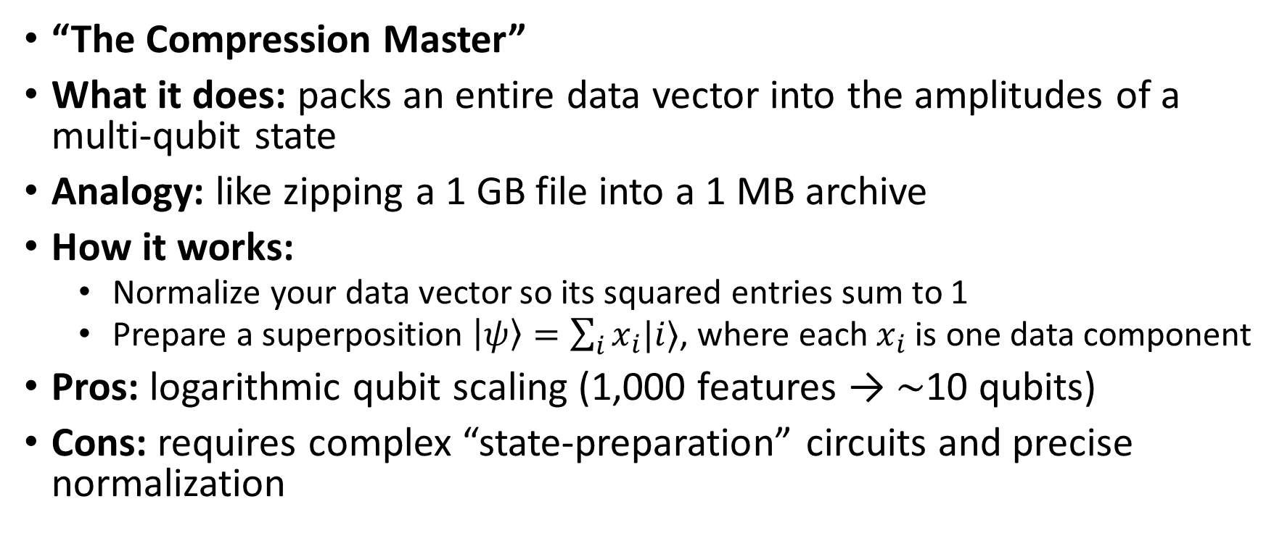
Method 1 – Amplitude Encoding
“The Compression Master”
What it does: packs an entire data vector into the amplitudes of a multi-qubit state
Analogy: like zipping a 1 GB file into a 1 MB archive
How it works:
Normalize your data vector so its squared entries sum to 1
Prepare a superposition $\left|ψ\right\rangle =\sum_{i}{x_{i}|i⟩}$, where each $x_{i}$ is one data component
Pros: logarithmic qubit scaling (1,000 features → ∼10 qubits)
Cons: requires complex “state-preparation” circuits and precise normalization

Slide 17
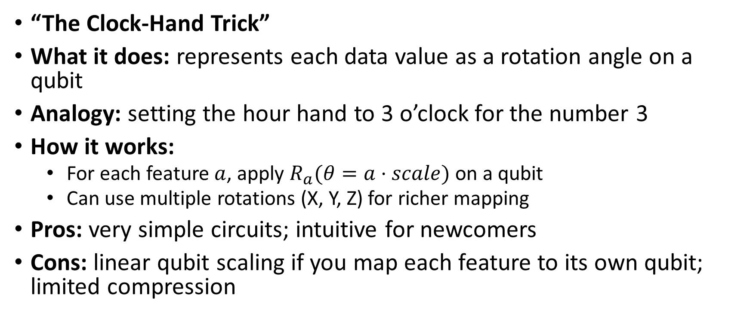
Method 2 – Angle Encoding
“The Clock-Hand Trick”
What it does: represents each data value as a rotation angle on a qubit
Analogy: setting the hour hand to 3 o’clock for the number 3
How it works:
For each feature $a$, apply $R_{a}(θ=a⋅scale)$ on a qubit
Can use multiple rotations (X, Y, Z) for richer mapping
Pros: very simple circuits; intuitive for newcomers
Cons: linear qubit scaling if you map each feature to its own qubit; limited compression

Slide 18
Method 3 – Basis Encoding
“The Direct Binary Copy”
What it does: maps each classical bit to a qubit’s basis state |0⟩ or |1⟩
Analogy: copying binary 10110 directly onto 5 light switches (off/on)
How it works:
For bit = 0, leave qubit in |0⟩; for bit = 1, apply an X-gate to get |1⟩
Pros: trivial to implement; minimal circuit depth
Cons: no compression, needs as many qubits as bits; impractical for large datasets

Slide 19
Encoding Comparison
Encoding Type | Qubit Count | Circuit Complexity | Compression | Use Cases | Example Quantum Algorithm
Amplitude | log₂(N) | High | Exponential | High-dimensional data | Quantum Principal Component Analysis (qPCA)
Angle | N | Low | None | Small-scale feature sets | Variational Quantum Classifier (VQC)
Basis | N | Minimal | None | Binary data, prototyping | Grover’s Search

Slide 20
How to Choose
Data size & dimensionality
If N ≫ qubit budget ⇒ consider amplitude encoding
If N small and you value simplicity ⇒ angle or basis encoding
Hardware constraints
Deep circuits (amplitude) ⇒ more error-prone on noisy devices
Shallow circuits (angle/basis) ⇒ better for today’s machines
Development effort
Amplitude encoding ⇒ more engineering time
Angle/basis ⇒ quick to prototype

Slide 21
What Are Feature Maps?
Camera-lens analogy: adjust focus to reveal hidden details
Formal definition: a parameterized quantum circuit that embeds classical data into a quantum state
Key purposes:
Project data into high-dimensional quantum space
Amplify subtle, non-linear patterns
Serve as the “kernel” for quantum algorithms (e.g. QSVM, QNN)

Slide 22
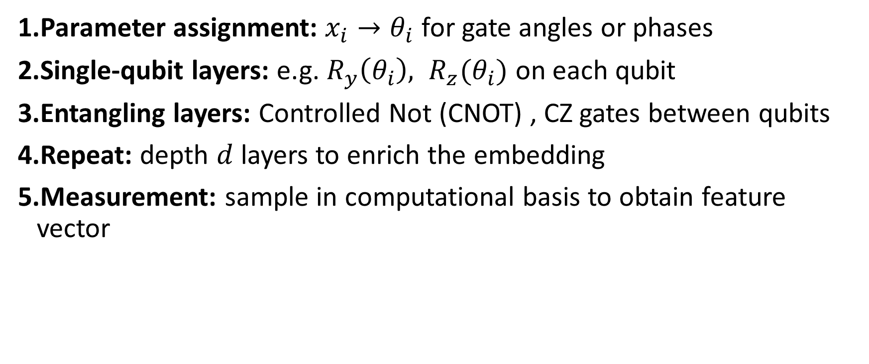
Circuit Mechanics of Feature Maps
Parameter assignment: $x_{i}→θ_{i}$​ for gate angles or phases
Single-qubit layers: e.g. $R_{y}\left(θ_{i}\right), R_{z}(θ_{i})$ on each qubit
Entangling layers: Controlled Not (CNOT) , CZ gates between qubits
Repeat: depth $d$ layers to enrich the embedding
Measurement: sample in computational basis to obtain feature vector

Slide 23
Pauli Feature Maps
What it does:
Applies simple rotations around X, Y, Z direction on each qubit using the data
Circuit look-and-feel:
Rotate qubit by data-driven angle about X
Rotate same qubit about Y, then Z
(Optional) Entangle qubits with CZ gates
Why it helps:
“3D sculpting” of data, captures each feature from three directions
Reveals patterns hidden along any axis

Slide 24
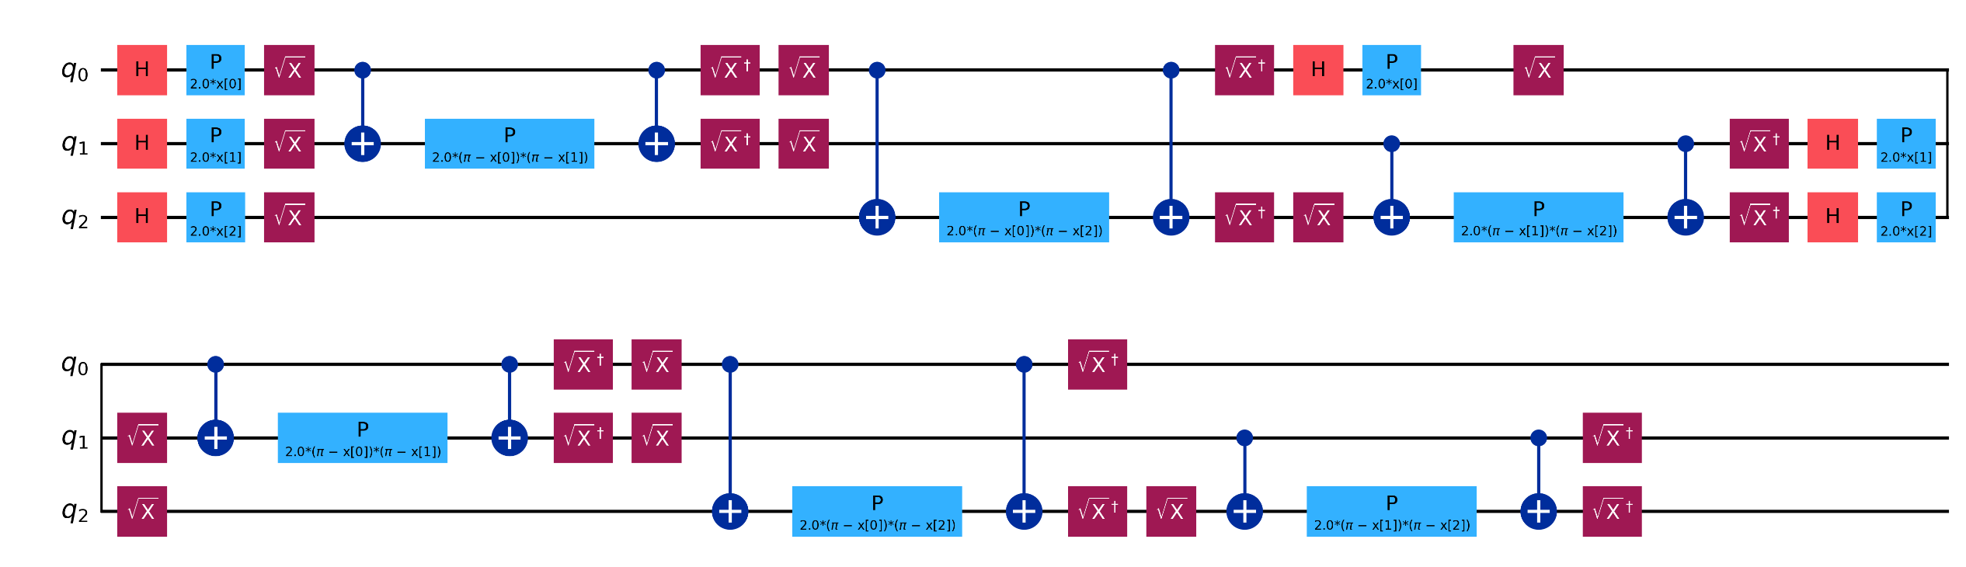
Pauli Feature Maps

Slide 25
ZZ Feature Maps
What it does:
Links pairs of qubits so their states shift together based on data
Circuit look-and-feel:
Rotate each qubit by its data-driven angle about Z
Apply a controlled-phase gate between qubit pairs
Repeat if needed for more links
Why it helps:
“Social network” of features, changing one feature ripples to its neighbor
Directly encodes relationships (A↔B) in your data

Slide 26
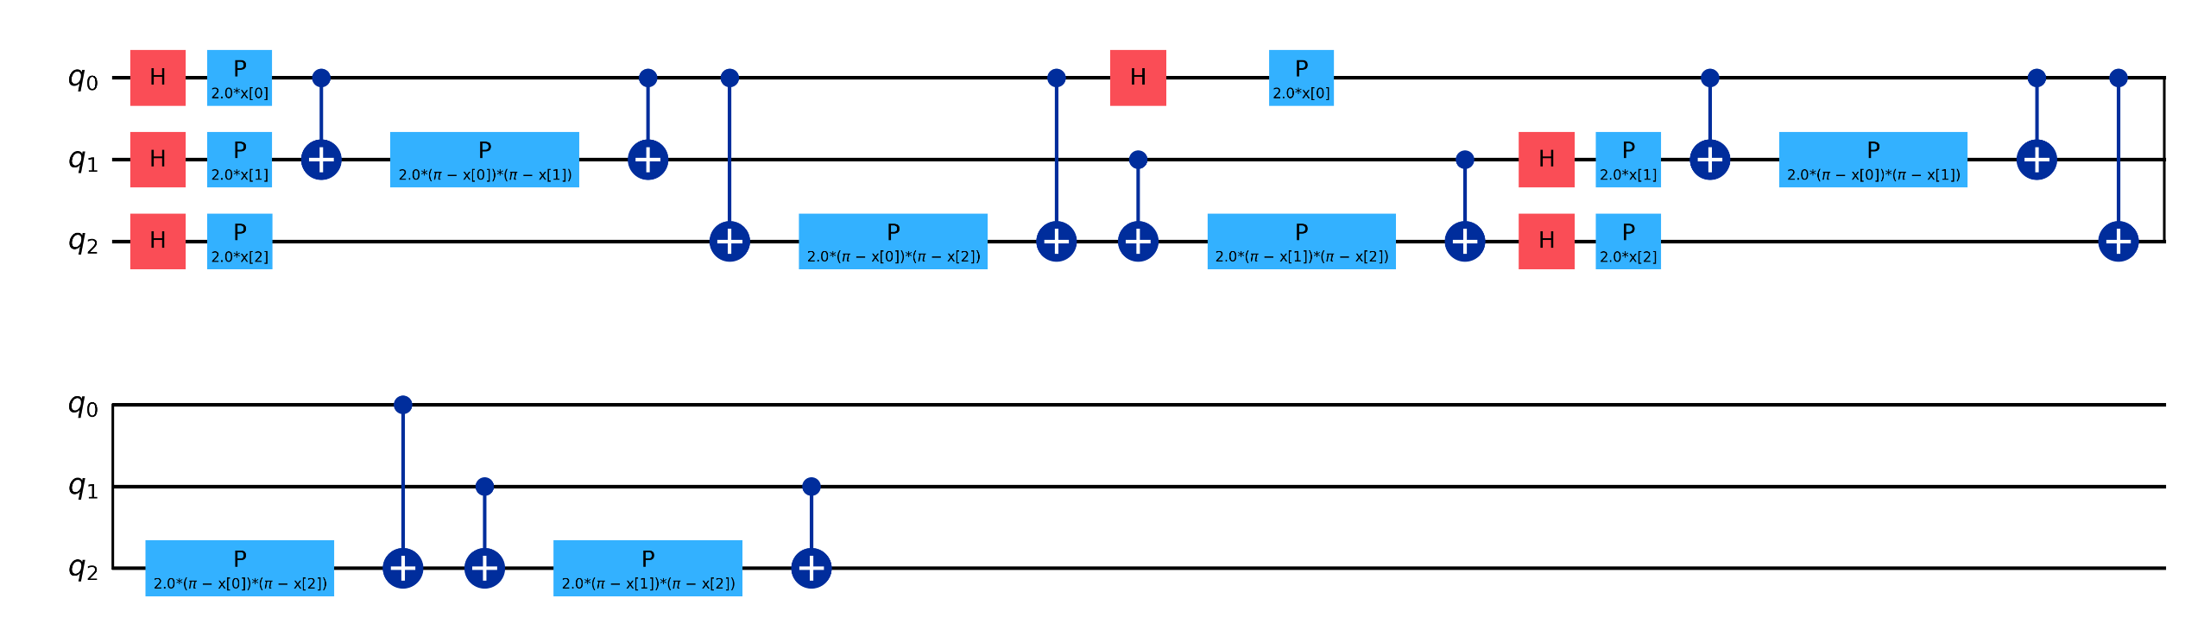
ZZ Feature Maps

Slide 27
Basic Encoding vs. Feature Maps
Aspect | Basic Encoding | Quantum Feature Map
Purpose | Load your data directly onto qubits | Transform and enrich data so hidden patterns become clear
Circuit | Simple. one rotation or data-load gate per feature | Layers of rotations plus gates that tie qubits together
Feature Space | Keeps the same dimensions as your input | Projects into a much larger “quantum” space for richer views
Patterns Captured | Only individual (linear) feature effects | Captures complex, multi-feature relationships via entanglement
When to Use | Quick demos or basic state preparation | Quantum-machine-learning tasks where you need extra power

Slide 28
Trainable (Parameterized) Quantum Circuits
Comparable to Tuning a Musical Instrument
Each gate parameter is like a tuning knob on an instrument
Adjust parameters (rotation angles) to “harmonize” the output with desired labels
Learning Process
Initialize: Start with random parameter settings
Evaluate: Run the circuit, measure outputs, compute a cost function
Update: Use classical optimizer (e.g., gradient descent) to tweak parameters
Iterate: Repeat until cost converges to a minimum
Why It Works
Analogous to neural networks’ weight tuning
Quantum operations offer richer transformations, potentially capturing complex patterns

Slide 29
Building Blocks of Quantum ML
Input Layer (Data Encoding)
Amplitude Encoding: Map data into amplitudes of a multi-qubit state
Angle Encoding: Use rotation gates (Rx, Ry, Rz) where angles represent feature values
Processing Layers (Variational Blocks)
Parameterized Gates: Rx(θ), Ry(φ), Rz(ψ) whose angles are trainable
Entangling Gates: CNOT, CZ to create correlations between qubits
Layered Structure: Repeated blocks to increase expressivity
Output Layer (Measurement + Readout)
Measure one or more qubits in the computational basis
Aggregate measurement probabilities into predictions (e.g., class label probabilities)
Classical post-processing (thresholding, softmax)

Slide 30
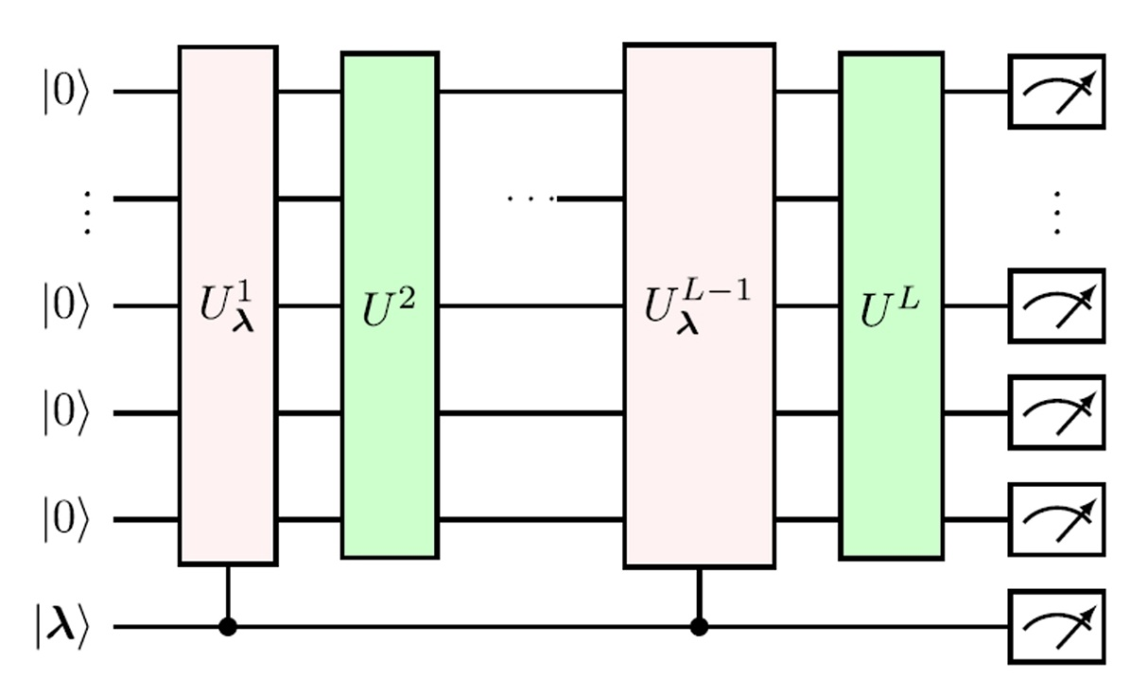
Parameterized Quantum Circuits
Parameterized Quantum Circuits are circuits where the gates are defined through tunable parameters, are a fundamental building block of near-term quantum machine learning algorithms.
Interchangeably called Variational Circuits or Variational Quantum Circuits.
As all quantum gates used in a quantum circuit are unitary, a parameterized circuit itself can be described as a unitary operation on n qubits.
We can use the measures of expressibility and entangling capability to discriminate between different parameterized quantum circuits.
In quantum machine learning, parameterized quantum circuits tend to be used for two things:
To encode data, where the parameters are determined by the data being encoded
As a quantum model, where the parameters are determined by an optimization process.

Slide 31
PQC vs VQC
Parameterized Quantum Circuits
Variational Quantum Circuits
A broad concept that encompasses any quantum circuit with adjustable parameters.
May or may not be used in an optimization context.
Usually used for Quantum Algorithms
A subset of PQCs that are specifically designed to be optimized using a variational (hybrid quantum-classical) approach.
Always involve an optimization process, where the parameters are actively tuned to minimize or maximize a cost function.
The term "variational" refers to the use of classical optimization algorithms.

Slide 32
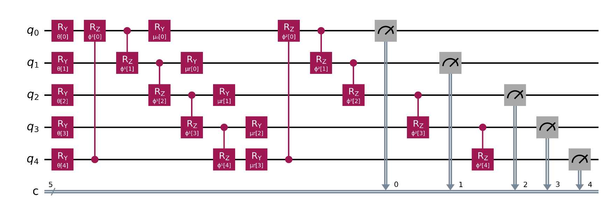
A Typical VQC used for QML

Slide 33
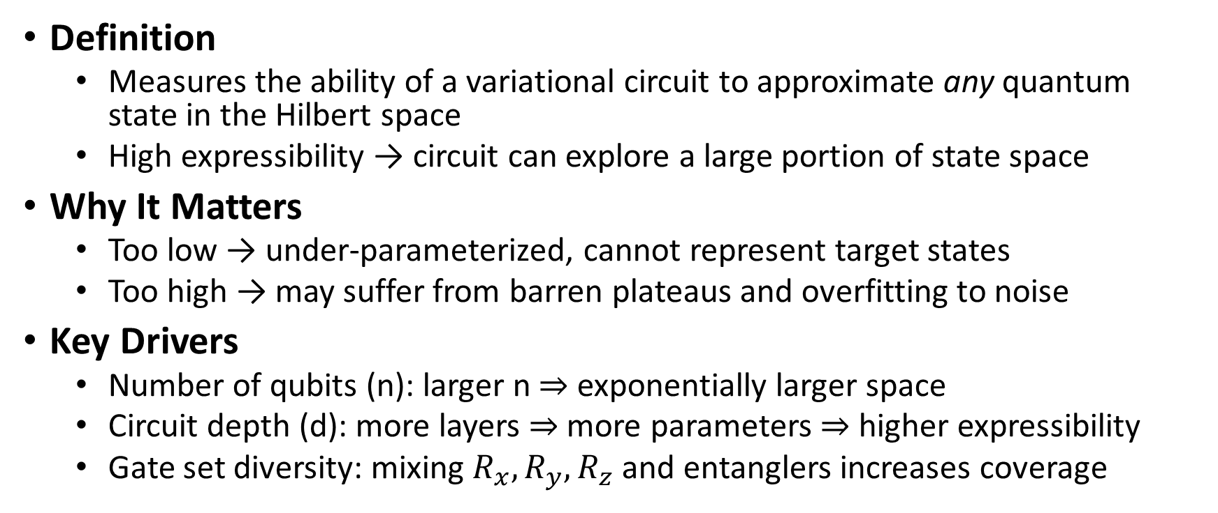
Expressibility of Quantum Circuits
Definition
Measures the ability of a variational circuit to approximate any quantum state in the Hilbert space
High expressibility → circuit can explore a large portion of state space
Why It Matters
Too low → under-parameterized, cannot represent target states
Too high → may suffer from barren plateaus and overfitting to noise
Key Drivers
Number of qubits (n): larger n ⇒ exponentially larger space
Circuit depth (d): more layers ⇒ more parameters ⇒ higher expressibility
Gate set diversity: mixing $R_{x}, R_{y}, R_{z}$ and entanglers increases coverage

Slide 34
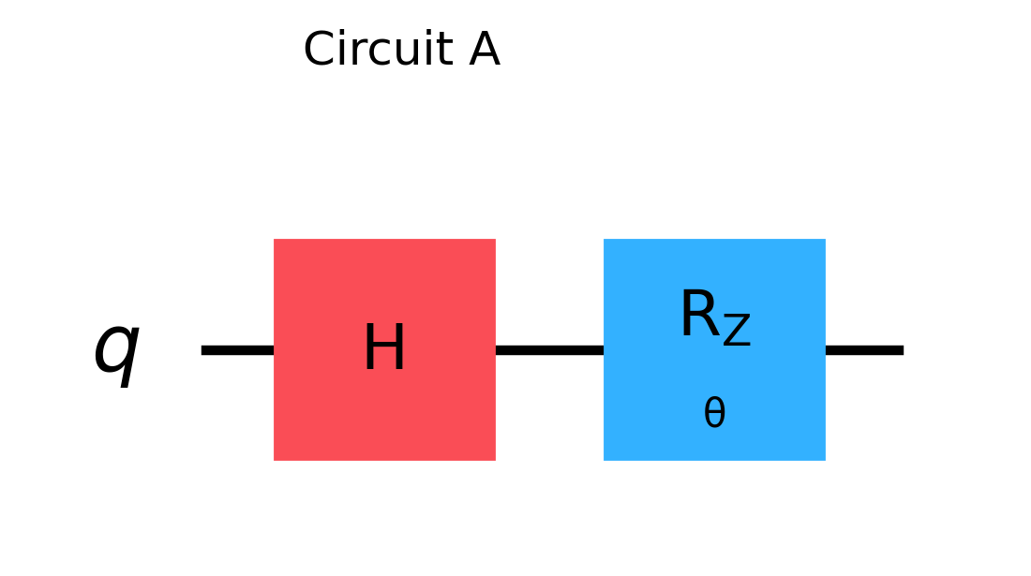
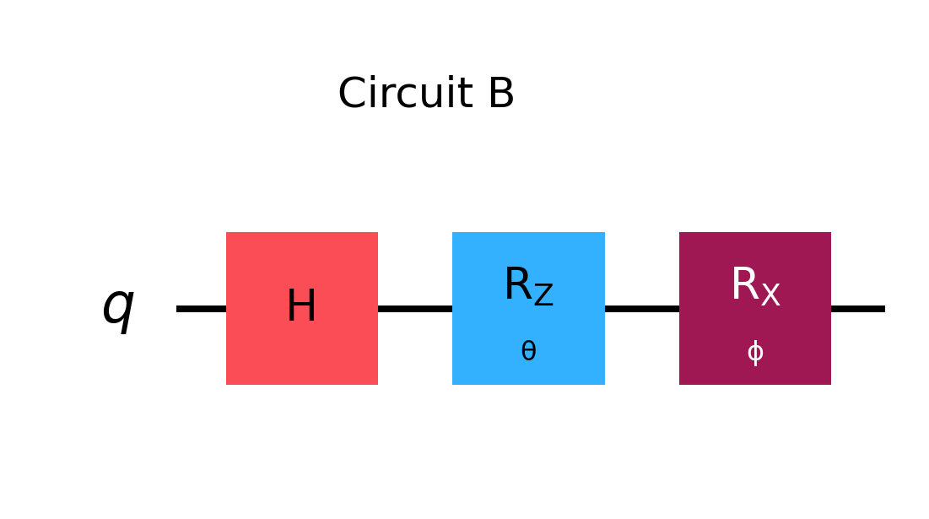
Expressibility of Quantum Circuits

Slide 35
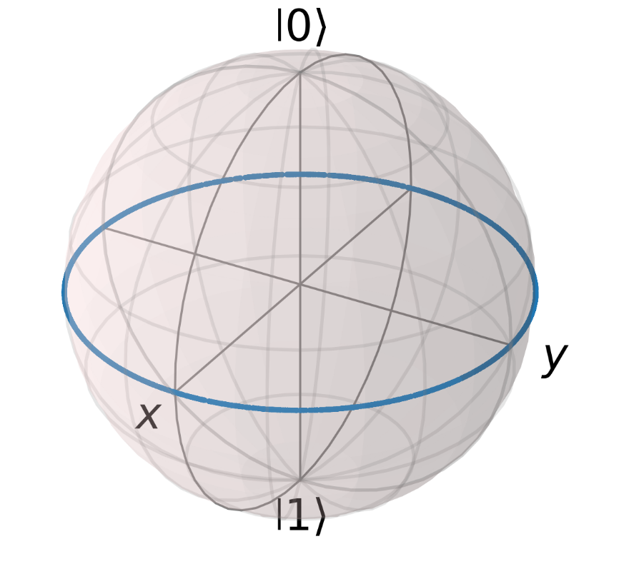
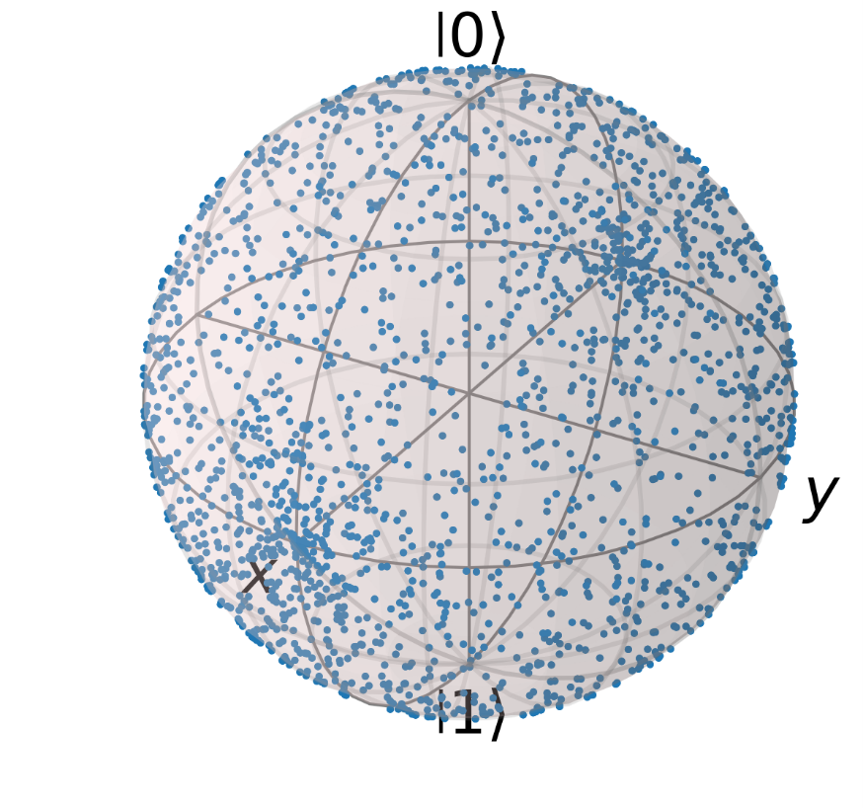
Expressibility of Quantum Circuits
Bloch Sphere for Circuit A
Bloch Sphere for Circuit B

Slide 36
Entangling Capability of Quantum Circuits
Definition
Circuit’s ability to generate multi-qubit entanglement from product (unentangled) inputs
Fundamental for quantum advantage in ML and optimization
Why It Matters
Insufficient entanglement → circuit behaves classically
Excessive entanglement can exacerbate noise sensitivity
Circuit Features
Placement of two-qubit gates (e.g., CNOT, CZ)
Connectivity graph (linear vs. full entanglement)
Number of entangling layers

Slide 37
Measuring Entangling Capability
Measure | What It Tells You | How You Measure It | Good For | Limitations
Entanglement Entropy | How “mixed up” two chunks of your qubits get together | Cut the qubits into two groups, compute the “surprise” in one group when you ignore the other (von Neumann entropy) | Gauging overall “connectedness” between halves | Gets hard to calculate as qubit number grows; depends on where you cut
Meyer–Wallach Q-Measure | How much each qubit is sharing information with the rest | For each qubit, see how “pure” it is by itself (trace of squared reduced state), average across all qubits | Quick check of global entanglement strength | Doesn’t say which qubits are talking to which; misses detailed structure

Slide 38
Designing the Ansatz
Hardware-Efficient Ansatz
Shallow circuits matched to device topology
Layers of native gates (e.g. repeated RX–RZ rotations + CNOT pairs)
Low depth → less noise accumulation
Limited expressibility for complex problems
Problem-Inspired Ansatz
Structure reflects problem Hamiltonian or symmetries.
Captures domain-specific features efficiently
Often deeper → more noise, device-dependent
Expressibility vs. Trainability Trade-Off
Trainability: ease of optimizing parameters (avoiding barren plateaus)
High expressibility → risk of barren plateaus (flat gradients)
Shallow, constrained ansatz → easier training but less flexible

Slide 39
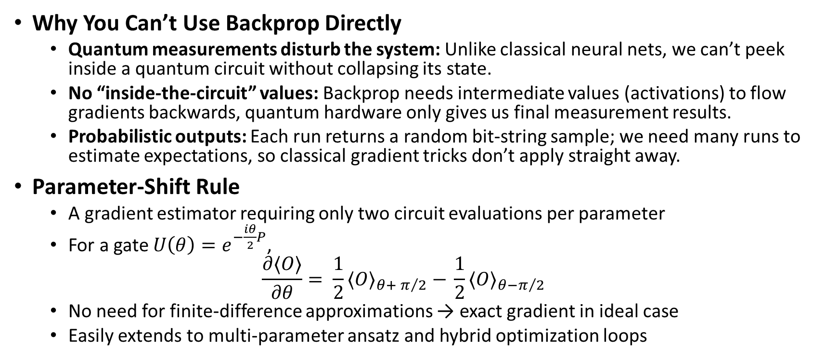
Gradient Computation in QML
Why You Can’t Use Backprop Directly
Quantum measurements disturb the system: Unlike classical neural nets, we can’t peek inside a quantum circuit without collapsing its state.
No “inside-the-circuit” values: Backprop needs intermediate values (activations) to flow gradients backwards, quantum hardware only gives us final measurement results.
Probabilistic outputs: Each run returns a random bit-string sample; we need many runs to estimate expectations, so classical gradient tricks don’t apply straight away.
Parameter-Shift Rule
A gradient estimator requiring only two circuit evaluations per parameter
For a gate $U\left(θ\right)=e^{−\frac{iθ}{2}P}$,
$$\frac{∂⟨O⟩}{∂θ}= \frac{1}{2}{⟨O⟩}_{θ+ π/2} − \frac{1}{2}{⟨O⟩}_{θ−π/2}$$
No need for finite-difference approximations → exact gradient in ideal case
Easily extends to multi-parameter ansatz and hybrid optimization loops

Slide 40
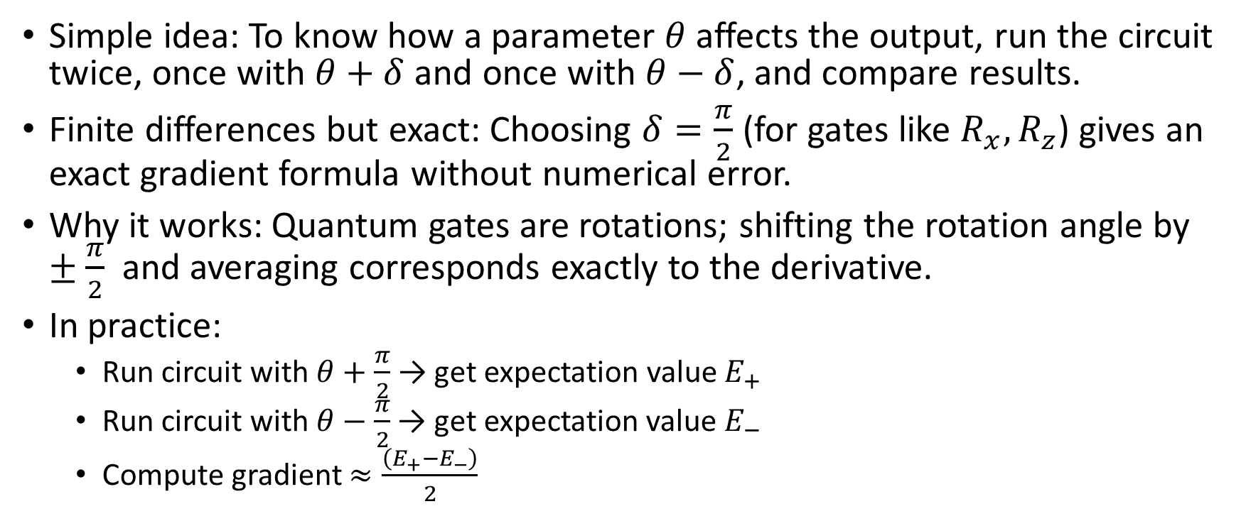
Parameter Shift Rule
Simple idea: To know how a parameter $θ$ affects the output, run the circuit twice, once with $θ+δ$ and once with $θ−δ$, and compare results.
Finite differences but exact: Choosing $δ=\frac{π}{2}$ (for gates like $R_{x},R_{z}$) gives an exact gradient formula without numerical error.
Why it works: Quantum gates are rotations; shifting the rotation angle by $±\frac{π}{2}$ and averaging corresponds exactly to the derivative.
In practice:
Run circuit with $θ+\frac{π}{2}$→ get expectation value $E_{+}$
Run circuit with $θ−\frac{π}{2}$ → get expectation value $E_{−}$
Compute gradient $≈\frac{\left(E_{+}−E_{−}\right)}{2}$

Slide 41
QML Workflow Overview
Data Loading: select features (e.g. two Iris flower measurements)
Quantum Encoding: angle‐encode each feature into qubit rotations (Rx(xᵢ))
Variational Circuit: entangle & rotate qubits with trainable parameters θ
Measurement: expectation value per qubit → raw model outputs
Optimization Loop: classical optimizer (e.g. Adam) updates θ to minimize cost

Slide 42
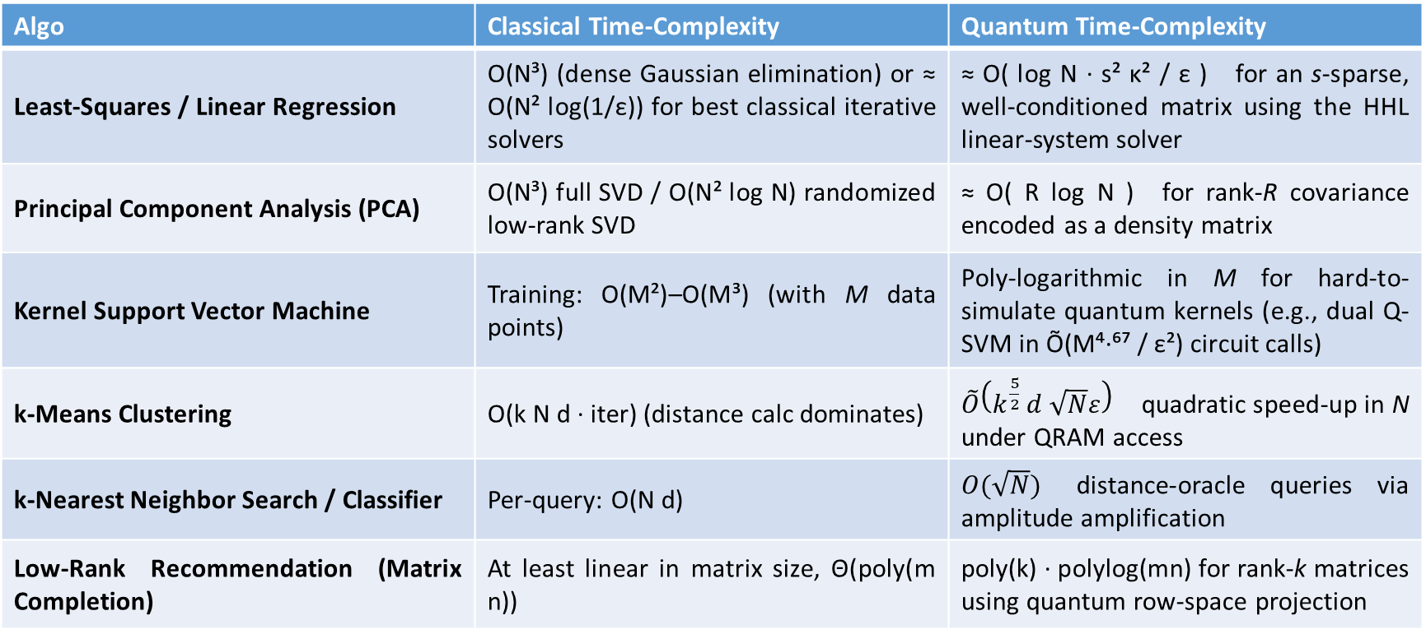
Classical ML vs Quantum ML
Algo | Classical Time-Complexity | Quantum Time-Complexity
Least-Squares / Linear Regression | O(N³) (dense Gaussian elimination) or ≈ O(N² log(1/ε)) for best classical iterative solvers | ≈ O( log N · s² κ² / ε ) for an s-sparse, well-conditioned matrix using the HHL linear-system solver
Principal Component Analysis (PCA) | O(N³) full SVD / O(N² log N) randomized low-rank SVD | ≈ O( R log N ) for rank-R covariance encoded as a density matrix
Kernel Support Vector Machine | Training: O(M²)–O(M³) (with M data points) | Poly-logarithmic in M for hard-to-simulate quantum kernels (e.g., dual Q-SVM in Õ(M⁴·⁶⁷ / ε²) circuit calls)
k-Means Clustering | O(k N d · iter) (distance calc dominates) | $\tilde{O}\left(k^{\frac{5}{2}} d \sqrt{N}ε\right)$quadratic speed-up in N under QRAM access
k-Nearest Neighbor Search / Classifier | Per-query: O(N d) | $O(\sqrt{N})$ distance-oracle queries via amplitude amplification
Low-Rank Recommendation (Matrix Completion) | At least linear in matrix size, Θ(poly(m n)) | poly(k) · polylog(mn) for rank-k matrices using quantum row-space projection

Slide 43
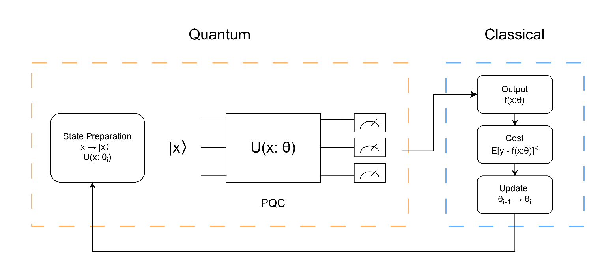
How QEML works
Data is first encoded into quantum state.
Preprocessing Approach: Classical data is first converted into quantum states using an initial quantum circuit, which are then used in the main quantum circuit.
Dynamic Encoding Approach: The quantum circuit itself performs data encoding as part of its operation, potentially using parameters derived from the data in real-time.
The data goes through series of gates and then the measurement is done using Pauli-Z expectation according to the number of shots we choose.
The output of the measurement is the fed to the optimizer that calculates the gradients based on the loss function that we choose.
The Parameters are then updated, and the cycle continues.

Slide 44
Why usually Pauli-Z expectation values are taken
Measuring in the Z-basis allows us to directly determine the probabilities of a quantum state collapsing to ∣0⟩ or ∣1⟩, where +1 corresponds to state ∣0⟩ and -1 corresponds to state ∣1⟩ .
By focusing on Pauli-Z, the process of extracting information from the quantum state is simplified, making it easier to integrate with classical machine learning algorithms.
This reduces the overall error in QML applications, which is crucial given the current limitations in quantum hardware.

Slide 45
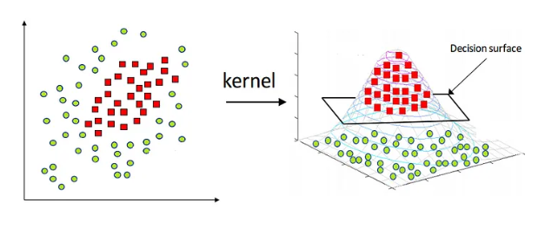
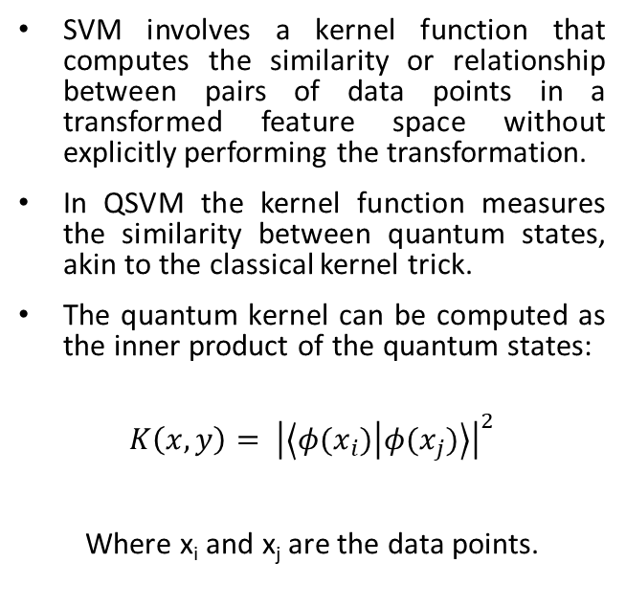
How QSVM works
SVM involves a kernel function that computes the similarity or relationship between pairs of data points in a transformed feature space without explicitly performing the transformation.
In QSVM the kernel function measures the similarity between quantum states, akin to the classical kernel trick.
The quantum kernel can be computed as the inner product of the quantum states:
$$K\left(x,y\right)= {\left|\left\langle φ(x_{i}) | φ(x_{j})\right\rangle \right|}^{2}$$
Where x_{i} and x_{j} are the data points.

Slide 46
How Quantum Properties can be used in SVM
Quantum Superposition:
Each data point is represented by a quantum state that can be in a superposition of different basis states.
For instance, if you have a feature vector x = [x1,x2], you encode it into a quantum state ∣ψ⟩ = α₀∣00⟩ + α₁∣01⟩ + α₂∣10⟩ + α₃∣11⟩, where α_{i} are coefficients representing different feature values.
Quantum Entanglement:
Entangling qubits can help compute complex kernel functions that capture non-trivial relationships between data points.
Entangled data points can reveal sophisticated feature interactions and improve classification accuracy.

Slide 47
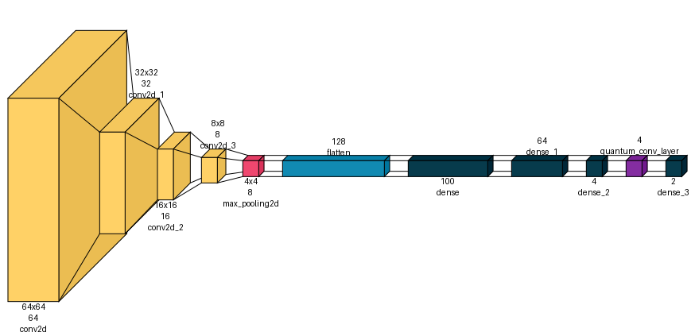
How QCNN works
Preprocess the images to rescale them between [0,1].
Currently Quantum Convolution can happen in two ways:
First we convolve through the image using our kernel size and then giving that input to the quantum circuit.
Second is to use classical convolutional operation to shrink down to useful information that can be directly processed by the quantum circuit
The output is then again evaluated against the metrics that we are trying to optimize.
The measurement might produce a binary result, which could correspond to a specific class label. For multi-class classification, additional post-processing of the measurement results may be required.

Slide 48
How Quantum Properties can be used in CNN
Quantum Superposition:
By leveraging superposition, the QCNN can perform feature extraction more efficiently, processing all locations simultaneously rather than sequentially.
This parallelism can provide a computational advantage by reducing the number of operations required to process high-dimensional data.
Quantum Entanglement:
The QCNN can model dependencies between distant regions of the input, which is particularly valuable in tasks like pattern recognition or anomaly detection.
For example, detecting local features such as edges, textures, and shapes in MRIs or CT scan by identifying irregularities or abnormalities that may indicate tumors, even if they are not close to each other.

Slide 49
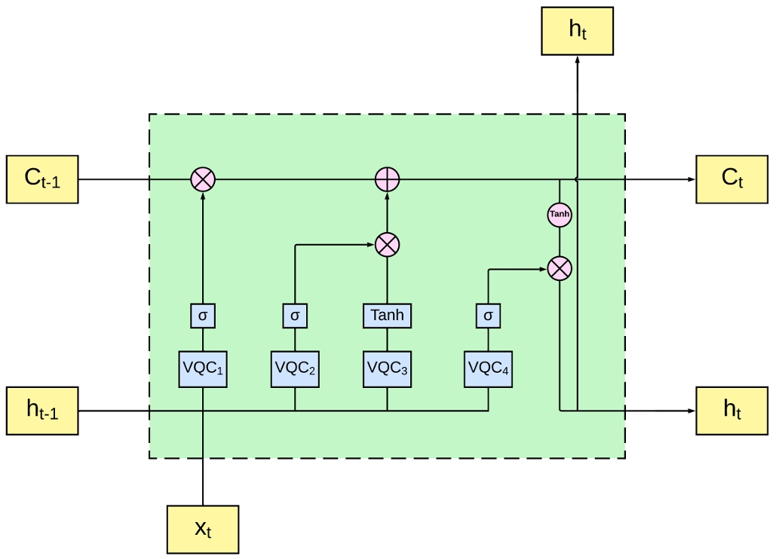
How Quantum NLP can be done
Generative Pre-trained Transformer or GPT is a type of large language model which utilize probability to predict the next token one at a time according to the context of input provided.
GPT calculates the attention scores of the word with the context and that allows the model to weigh the importance of different words in a sequence relative to each other.
Quantum circuits could compute attention scores in parallel, leveraging quantum parallelism to process multiple sequences or contexts simultaneously.

Slide 50
How Quantum Properties can be used in NLP
Quantum Entanglement
allows the model to capture complex dependencies and relationships between tokens
When tokens are entangled, changes in the state of one token (e.g., through interaction with another word) directly affect the state of the entangled tokens.
Quantum Superposition
Each token can exist in a superposition of multiple meanings or contexts.
For example, "saw" could simultaneously represent different grammatical tenses or associations, depending on context.

Slide 51
Applications of QML
Quantum Data Classification: In fields like finance and healthcare, where data classification is crucial, QML can enhance the speed and accuracy of categorizing data.
Quantum Chemistry and Drug Discovery: QML is being applied to simulate molecular structures more efficiently, aiding in the discovery of new drugs.
Natural Language Processing (NLP): Quantum computing could enhance NLP tasks like translation, sentiment analysis, and summarization by processing large text datasets more efficiently.
Advanced Cryptography and Cybersecurity: Quantum machine learning could be used to create more secure encryption methods and detect anomalies in network traffic faster than classical systems.

Slide 52
Limitations & Open Challenges
Scalability
Qubit Count & Coherence: Current NISQ devices top out at a few dozen qubits with less coherence times, limiting algorithm depth and data size.
Error Correction Overhead: Achieving fault tolerance requires encoding logical qubits via parity codes, with overhead growing exponentially in physical.
Hardware Engineering: Scaling beyond tens of qubits demands complex cryogenics and control electronics that introduce latency and thermal noise.
Practical Speedups: Theoretical quantum advantage often vanishes on real hardware due to limited qubit counts and high error rates.

Slide 53
Limitations & Open Challenges
Barren Plateaus
Vanishing Gradients: Randomly initialized variational circuits exhibit exponentially flat loss landscapes, requiring exponentially many evaluations to find a descent direction.
Depth & Connectivity Effects: Even shallow circuits with global cost functions can enter barren regions, making ansatz design crucial.
Mitigation Efforts: Layer wise training and structured ansatzes show promise but no universal cure exists; optimization remains a research frontier.
Noise-Induced Plateaus: Real-device noise exacerbates gradient decay, demanding sophisticated error‐mitigation techniques alongside algorithmic fixes

Slide 54
Limitations & Open Challenges
Data Loading Bottlenecks
Quantum Data Encoding: Mapping an N-dimensional classical vector into qubits typically costs O(N) gates or relies on QRAM, which is still largely theoretical.
High-Dimensional Inputs: Unstructured datasets (images, text embeddings) drastically increase circuit depth and gate count for amplitude or angle encoding.
Classical–Quantum I/O: Hybrid QML workflows loop between classical optimizers and quantum measurements, creating transfer bottlenecks that negate potential speedups.
Advanced Loading Schemes: Techniques like quantum GANs or Boltzmann machines can streamline loading but introduce extra circuit complexity and resource demands

Slide 55
Resources for QML
Quantum ML – YouTube Channel
Research Papers by Maria Schuld and Seth Lyyod
Quantum Machine Intelligence – Springer Journal
IBM Quantum Experience and Qiskit Textbook
Qiskit Machine Learning and Pennylane libraries.
Quantum Machine Learning: What Quantum Computing Means to Data Mining (Peter Wittek)
A Practical Guide to Quantum Machine Learning and Quantum Optimization: Hands-on Approach to Modern Quantum Algorithms. Elías F. Combarro Fernández-Combarro Álvarez. packt publishing

Slide 56
Thank You

